Slide 1
27 – Clean Code – Design Patterns – Strategy and Template Patterns
Based on the CleanCoders videos by Uncle Bob Martin
Rupert Waldron

Slide 2
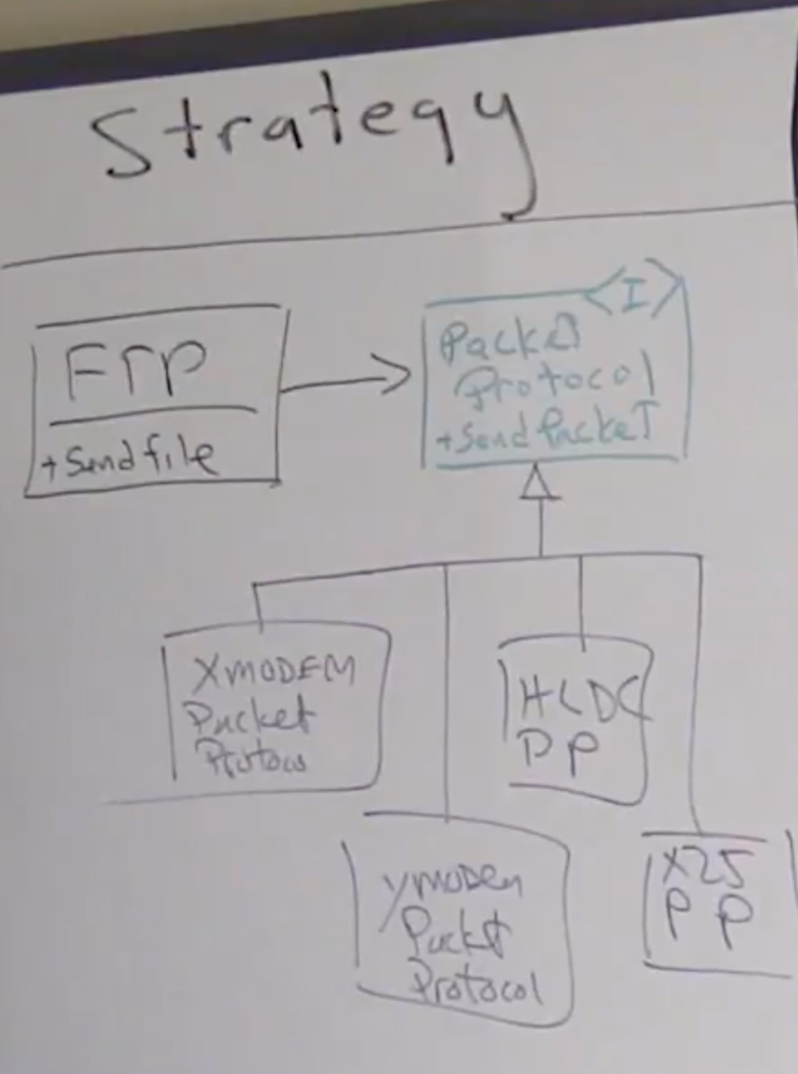
The Strategy Pattern
Strategy pattern lets us separate high level policy from low level details
Example – FTP – sends a file across the network using a variety of protocols
The high level policy (FTP) doesn’t care which protocol is being used
With design patterns if often helps to name the relevant classes using the name of the pattern applied. You could use PacketProtocolStrategy for example.
Isn’t this just basic polymorphism?

Slide 3
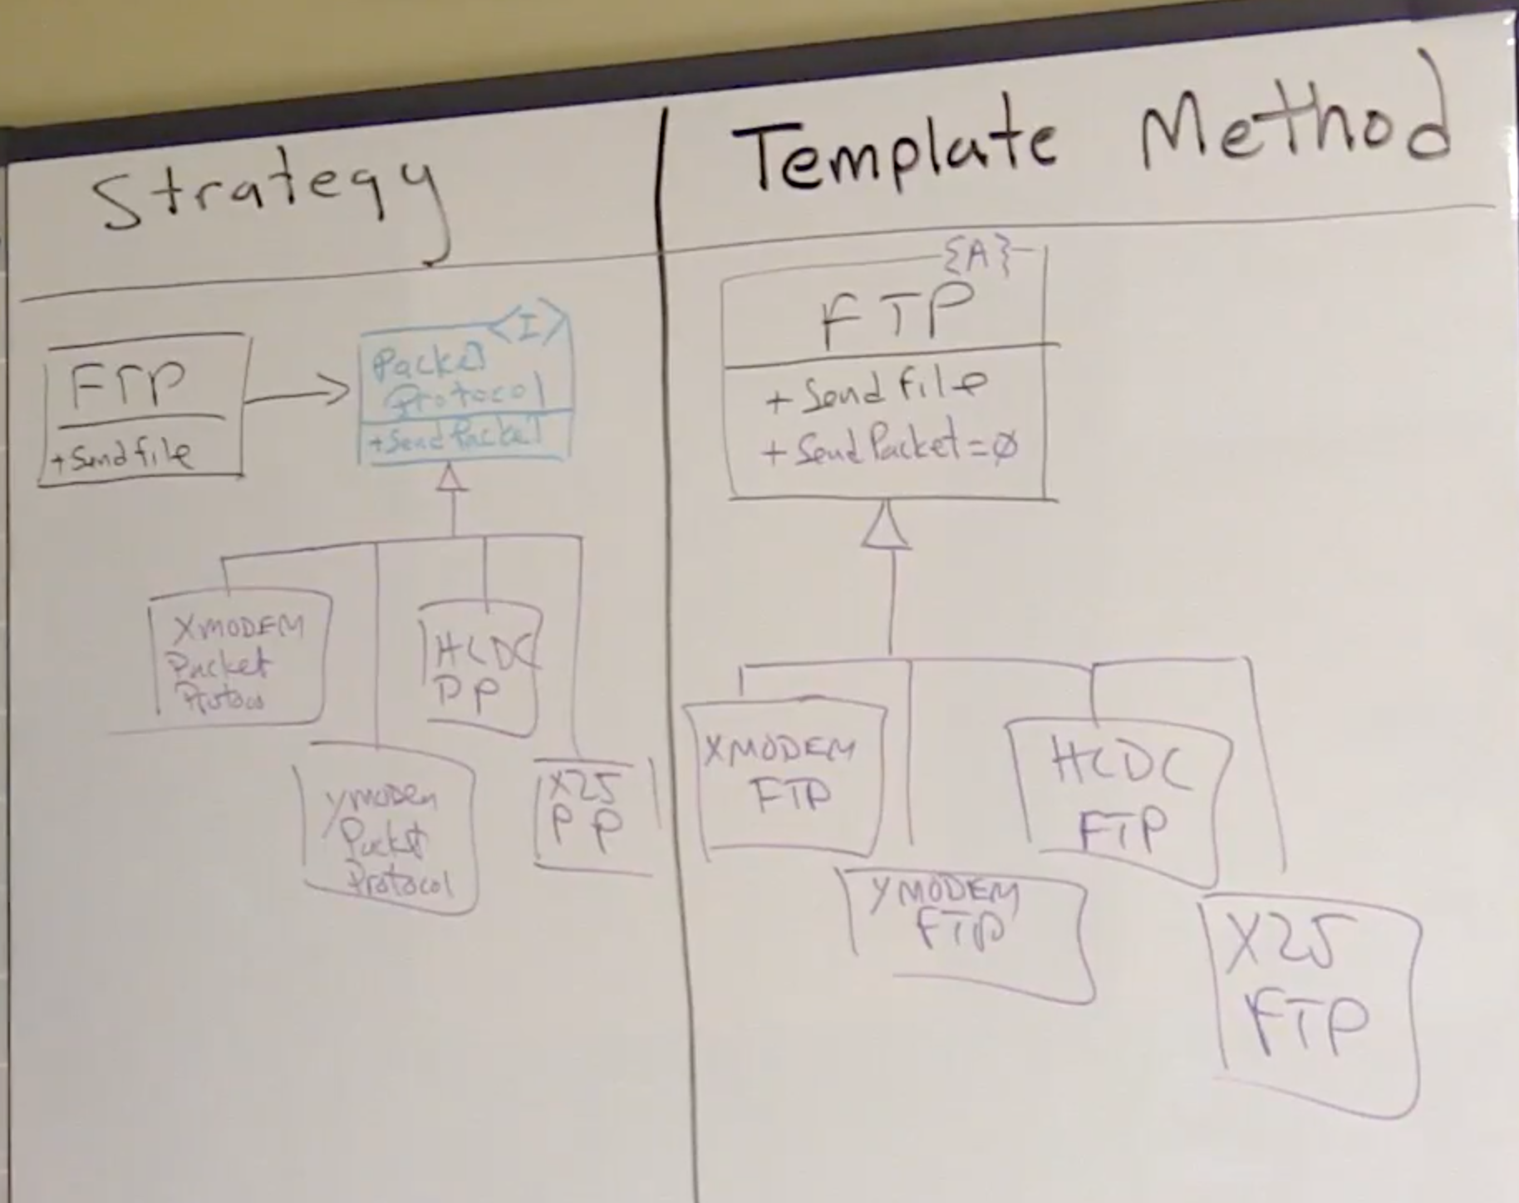
Template Pattern
Template method aims to achieve the same as the Strategy pattern but uses Internal Polymorphism rather than External Polymorphism like in the Strategy pattern.

Slide 4
Template Pattern vs Strategy Pattern
Strategy Pattern
2 instances: FTP and PacketProtocol derivative.
Need to create to objects and ‘link’ them together – harder
Can separate out the derivatives from the FTP and interface into different modules. Can combine them in a different module – flexible deployment.
High-level policy and low-level implementation are independent of each other. You can hot-swap the strategy / derivative anytime you want which gives much more flexibility
Template Pattern
1 instance: FTP derivative
Only need to create one object – easier
Less classes so a bit faster and uses less memory
High-level policy is independent upon low-level implementation. However low level implementation is strongly coupled to high-level policy – inheritance has a high degree of coupling – sharing instance variables.

Slide 5
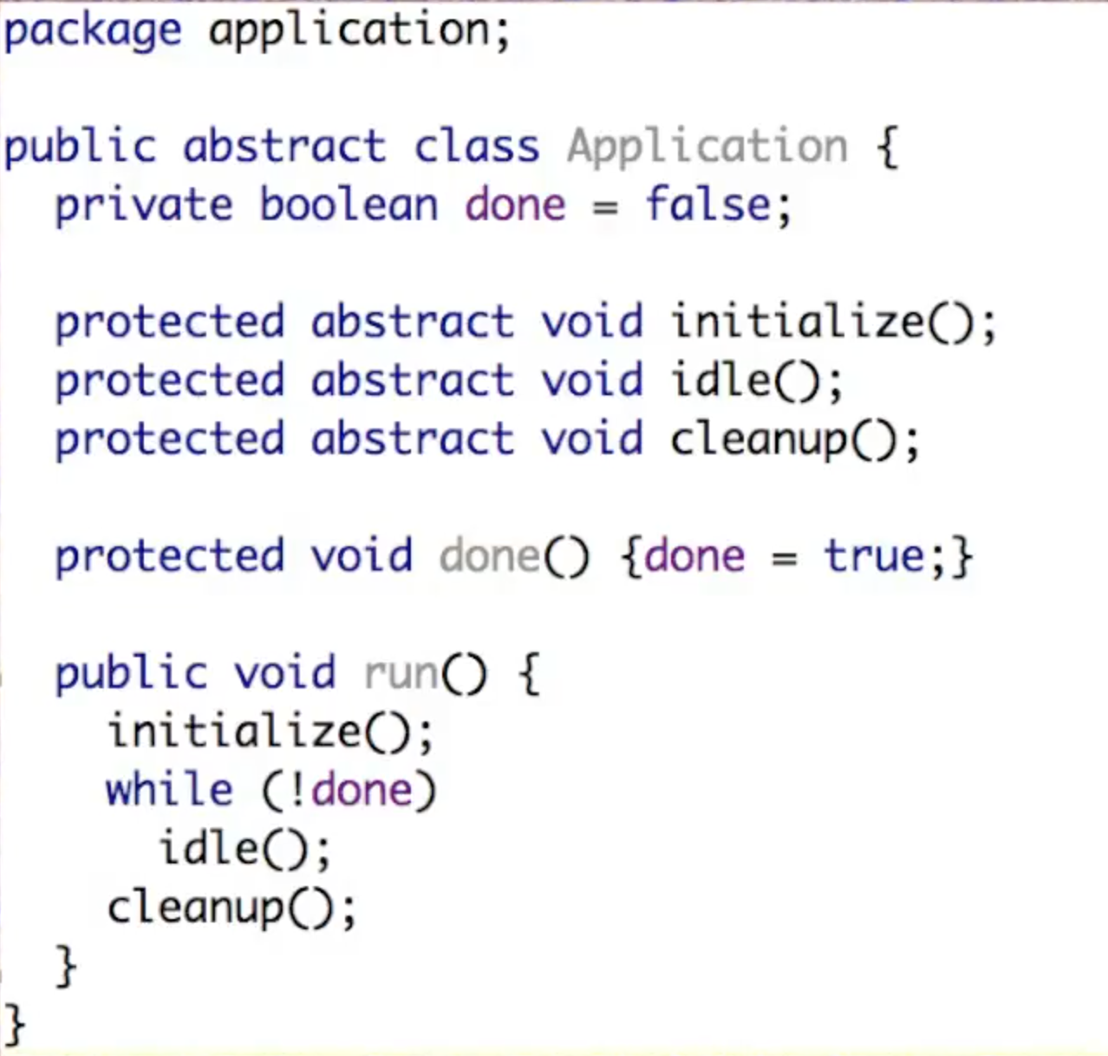
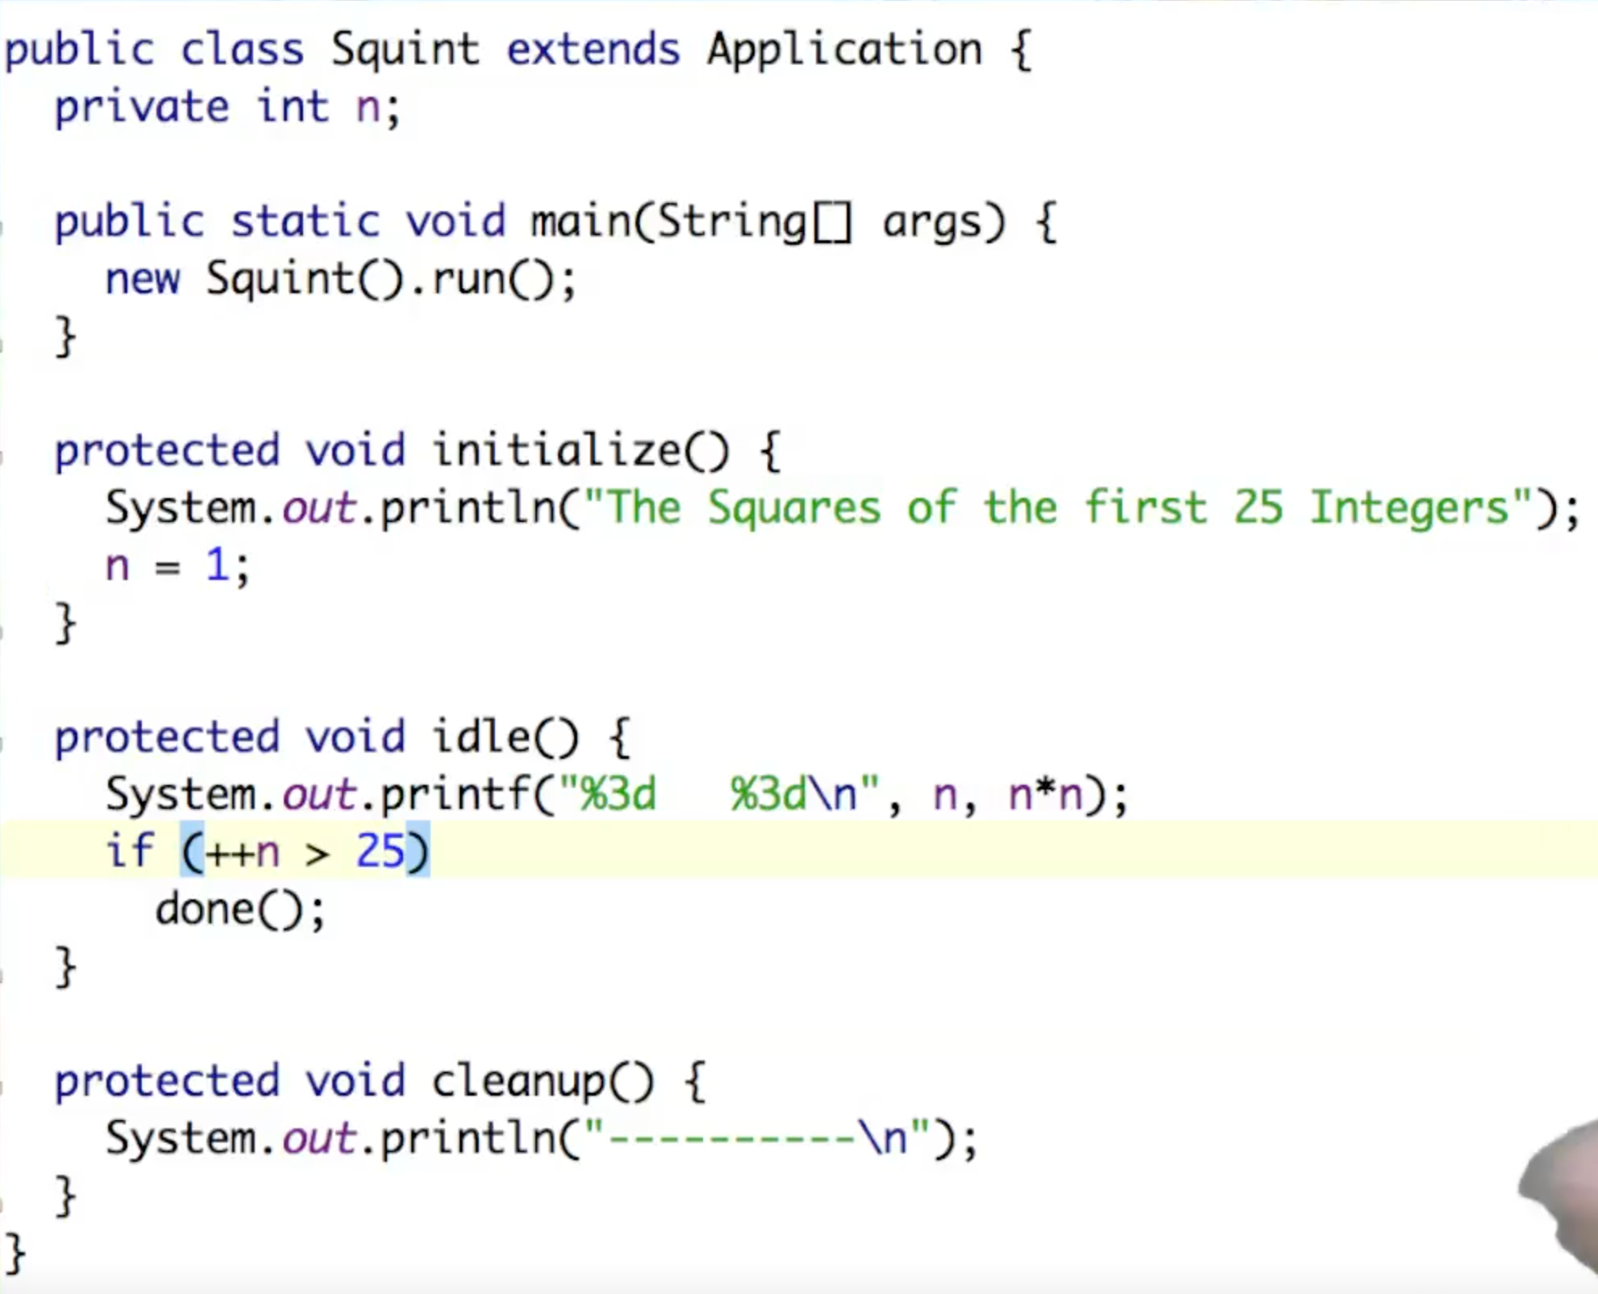
Application Frameworks and the Template Pattern

Slide 6
What is wrong with just doing this?
public class Squint { public static void main(String[] args) { System.out.println("The Squares of the first 25 Integers"); for (int n = 1; n<=25; n++) System.out.printf("%3d %3d\n", n, n*n); System.out.println("----------\n"); } }
Don’t go over-board with the use of design patterns

Slide 7
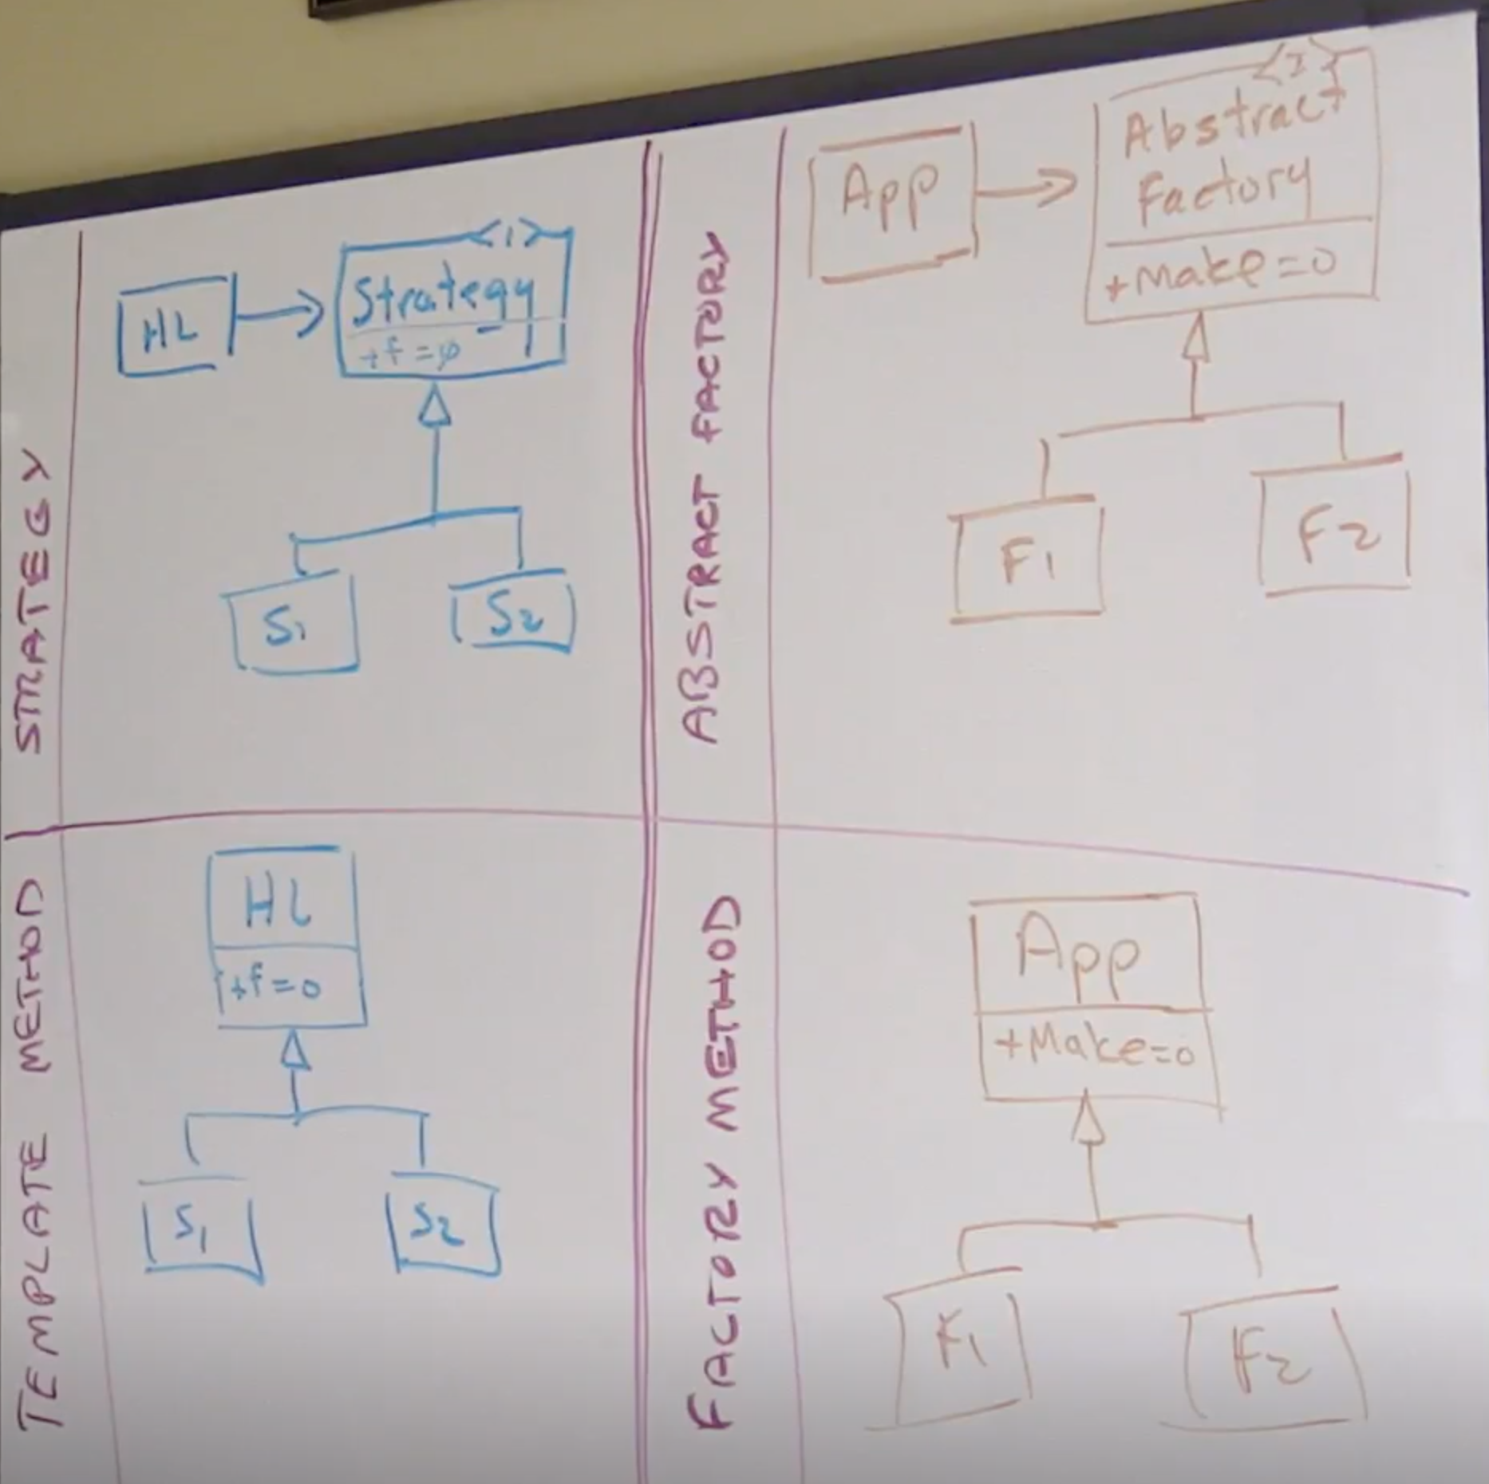
Abstract factory is a special case of Strategy Pattern
Factory method is a special case of the Template Pattern

